Slide 1
A Guide to SQL, Ninth Edition
Chapter Two
Database Design Fundamentals

Slide 2
Objectives
Understand the terms entity, attribute, and relationship
Understand the terms relation and relational database
Understand functional dependence and be able to identify when one column is functionally dependent on another
Understand the term primary key and identify primary keys in tables
©2016 Cengage Learning. All Rights Reserved. May not be copied, scanned, or duplicated, in whole or in part, except for use as permitted in a license distributed with a certain product or service or otherwise on a password-protected website for classroom use.

Slide 3
Objectives (continued)
Design a database to satisfy a set of requirements
Convert an unnormalized relation to first normal form
Convert tables from first normal form to second normal form
Convert tables from second normal form to third normal form
©2016 Cengage Learning. All Rights Reserved. May not be copied, scanned, or duplicated, in whole or in part, except for use as permitted in a license distributed with a certain product or service or otherwise on a password-protected website for classroom use.

Slide 4
Objectives (continued)
Create an entity-relationship diagram to represent the design of a database
©2016 Cengage Learning. All Rights Reserved. May not be copied, scanned, or duplicated, in whole or in part, except for use as permitted in a license distributed with a certain product or service or otherwise on a password-protected website for classroom use.

Slide 5
Introduction
Database design
  Process of determining the particular tables and columns that will comprise a database
Must understand database concepts
Process of normalization
©2016 Cengage Learning. All Rights Reserved. May not be copied, scanned, or duplicated, in whole or in part, except for use as permitted in a license distributed with a certain product or service or otherwise on a password-protected website for classroom use.

Slide 6
Database Concepts
Entity
Attribute
Relationship
Functional dependence
Primary key
©2016 Cengage Learning. All Rights Reserved. May not be copied, scanned, or duplicated, in whole or in part, except for use as permitted in a license distributed with a certain product or service or otherwise on a password-protected website for classroom use.

Slide 7
Relational Database
A collection of tables
Tables in TAL Distributors Database
  Rep
  Customer
  Orders
  Item
  Order_Line
©2016 Cengage Learning. All Rights Reserved. May not be copied, scanned, or duplicated, in whole or in part, except for use as permitted in a license distributed with a certain product or service or otherwise on a password-protected website for classroom use.

Slide 8
Entities, Attributes, and Relationships
Entity (like a noun)
  A person, place, thing, or event
Attribute (like an adjective or adverb)
  Property of an entity
Relationship
  Association between entities
©2016 Cengage Learning. All Rights Reserved. May not be copied, scanned, or duplicated, in whole or in part, except for use as permitted in a license distributed with a certain product or service or otherwise on a password-protected website for classroom use.

Slide 9
Entities, Attributes, and Relationships (continued)
One-to-many relationship
  One rep is related to many customers
  Implement by having a common column in two or more tables
    REP_NUM is a column in the CUSTOMER table and the REP table
Repeating groups
  Multiple entries in an individual location
©2016 Cengage Learning. All Rights Reserved. May not be copied, scanned, or duplicated, in whole or in part, except for use as permitted in a license distributed with a certain product or service or otherwise on a password-protected website for classroom use.

Slide 10
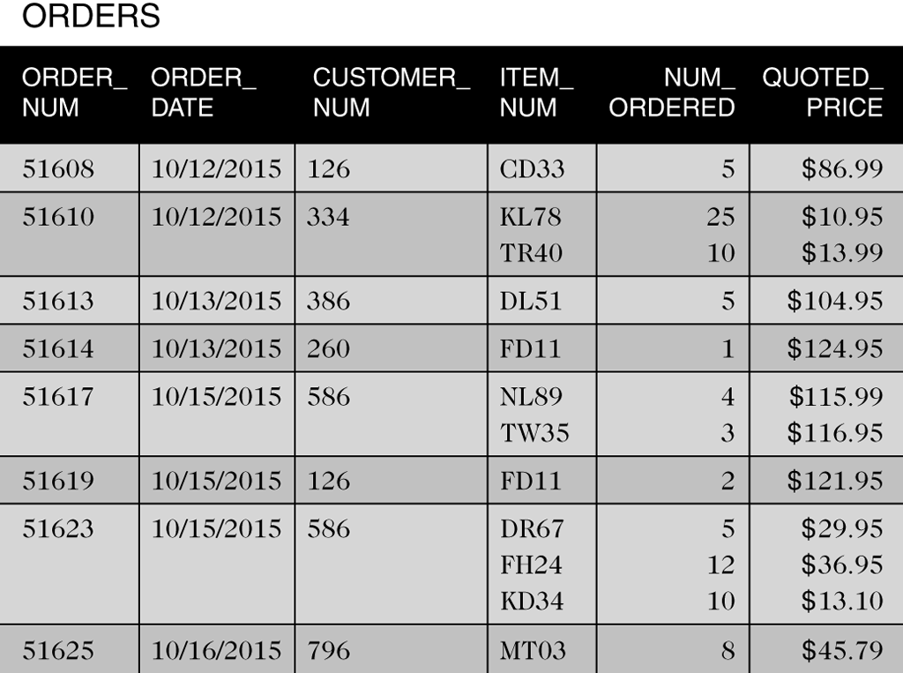
Entities, Attributes, and Relationships (continued)
Figure 2-2 Table with repeating groups
©2016 Cengage Learning. All Rights Reserved. May not be copied, scanned, or duplicated, in whole or in part, except for use as permitted in a license distributed with a certain product or service or otherwise on a password-protected website for classroom use.

Slide 11
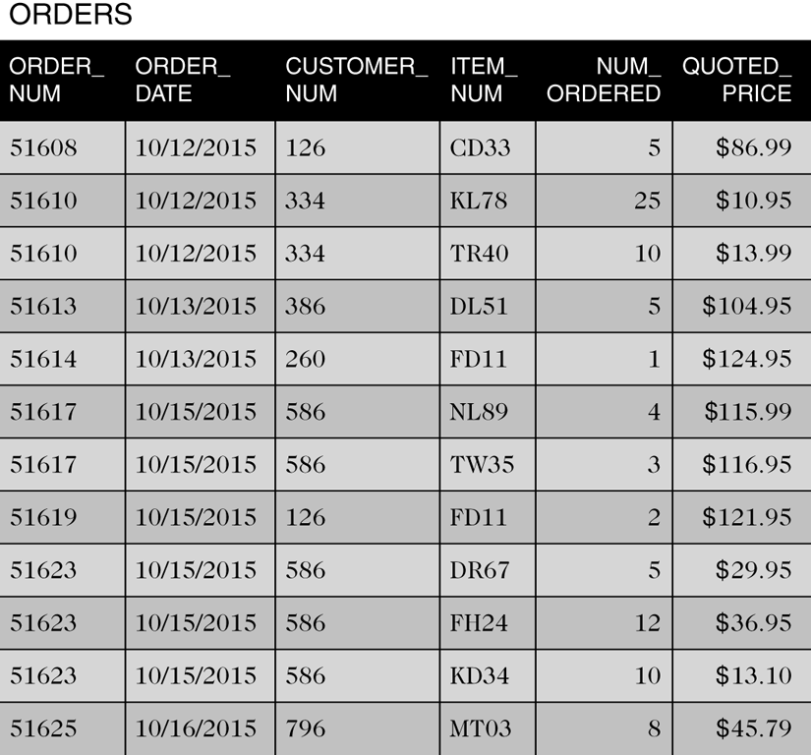
Entities, Attributes, and Relationships (continued)
Figure 2-3 ORDERS table without repeating groups
©2016 Cengage Learning. All Rights Reserved. May not be copied, scanned, or duplicated, in whole or in part, except for use as permitted in a license distributed with a certain product or service or otherwise on a password-protected website for classroom use.

Slide 12
Entities, Attributes, and Relationships (continued)
Relation is a two-dimensional table
  Entries in the table are single-valued
  Each column has a distinct name
  All values in a column are values of the same attribute
  The order of the columns is immaterial
  Each row is distinct
  The order of the rows is immaterial
©2016 Cengage Learning. All Rights Reserved. May not be copied, scanned, or duplicated, in whole or in part, except for use as permitted in a license distributed with a certain product or service or otherwise on a password-protected website for classroom use.

Slide 13
Entities, Attributes, and Relationships (continued)
Use shorthand representation to show tables and columns
REP (REP_NUM, LAST_NAME, FIRST_NAME, STREET,
CITY, STATE, POSTAL_CODE, COMMISSION, RATE)
CUSTOMER (CUSTOMER_NUM, CUSTOMER_NAME, STREET, CITY, STATE, POSTAL_CODE, BALANCE, CREDIT_LIMIT, REP_NUM)
ORDERS (ORDER_NUM, ORDER_DATE, CUSTOMER_NUM)
ORDER_LINE (ORDER_NUM, ITEM_NUM, NUM_ORDERED,
QUOTED_PRICE)
ITEM (ITEM_NUM, DESCRIPTION, ON_HAND, CATEGORY,
STOREHOUSE, PRICE)
©2016 Cengage Learning. All Rights Reserved. May not be copied, scanned, or duplicated, in whole or in part, except for use as permitted in a license distributed with a certain product or service or otherwise on a password-protected website for classroom use.

Slide 14
Functional Dependence
An attribute, B, is functionally dependent on another attribute (or collection), A, if a value for A determines a single value for B at any one time
B is functionally dependent on A
A B
A functionally determines B
Cannot determine from sample data; must know the users’ policies
©2016 Cengage Learning. All Rights Reserved. May not be copied, scanned, or duplicated, in whole or in part, except for use as permitted in a license distributed with a certain product or service or otherwise on a password-protected website for classroom use.

Slide 15
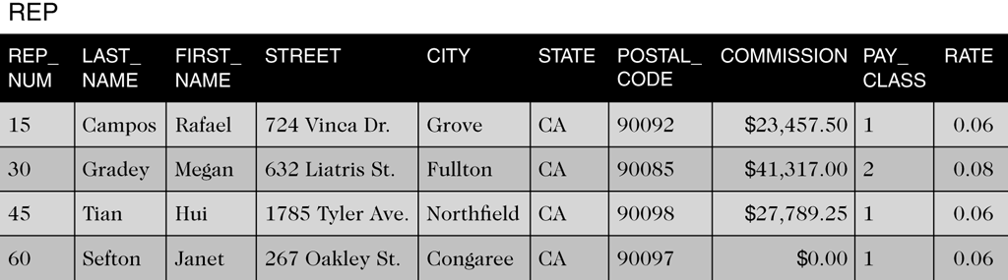
Functional Dependence (continued)
Figure 2-4 REP table with a PAY_CLASS column
©2016 Cengage Learning. All Rights Reserved. May not be copied, scanned, or duplicated, in whole or in part, except for use as permitted in a license distributed with a certain product or service or otherwise on a password-protected website for classroom use.

Slide 16
Primary Keys
Unique identifier for a table
Column (attribute) A (or a collection of columns) is the primary key for a table (relation), R, if:
  All columns in R are functionally dependent on A
  No subcollection of the columns in A (assuming that A is a collection of columns and not just a single column) also has Property 1
©2016 Cengage Learning. All Rights Reserved. May not be copied, scanned, or duplicated, in whole or in part, except for use as permitted in a license distributed with a certain product or service or otherwise on a password-protected website for classroom use.

Slide 17
Database Design
Given a set of requirements that the database must support
Requirements gathered through a process known as systems analysis
©2016 Cengage Learning. All Rights Reserved. May not be copied, scanned, or duplicated, in whole or in part, except for use as permitted in a license distributed with a certain product or service or otherwise on a password-protected website for classroom use.

Slide 18
Design Method
Read the requirements, identify the entities (objects) involved, and name the entities
Identify the unique identifiers for the entities identified in step 1
Identify the attributes for all the entities
Identify the functional dependencies that exist among the attributes
Use the functional dependencies to identify the tables by placing each attribute with the attribute or minimum combination of attributes on which it is functionally dependent
Identify any relationships between tables.
©2016 Cengage Learning. All Rights Reserved. May not be copied, scanned, or duplicated, in whole or in part, except for use as permitted in a license distributed with a certain product or service or otherwise on a password-protected website for classroom use.

Slide 19
Database Design Requirements
For TAL Distributors
  Must store data about sales reps, customers, items, orders, and order lines
  Must enforce certain constraints; for example:
    There is only customer per order
    On a given order, there is at most one line item for a given item
    The quoted price may differ from the actual price
©2016 Cengage Learning. All Rights Reserved. May not be copied, scanned, or duplicated, in whole or in part, except for use as permitted in a license distributed with a certain product or service or otherwise on a password-protected website for classroom use.

Slide 20
Database Design Process Example
Apply requirements to six steps in design method
©2016 Cengage Learning. All Rights Reserved. May not be copied, scanned, or duplicated, in whole or in part, except for use as permitted in a license distributed with a certain product or service or otherwise on a password-protected website for classroom use.

Slide 21
Normalization
Identify the existence of potential problems
Provides a method for correcting problems
Goal
  Convert unnormalized relations (tables that contain repeating groups) into various types of normal forms
©2016 Cengage Learning. All Rights Reserved. May not be copied, scanned, or duplicated, in whole or in part, except for use as permitted in a license distributed with a certain product or service or otherwise on a password-protected website for classroom use.

Slide 22
Normalization (continued)
1 NF
  Better than unnormalized
2 NF
  Better than 1 NF
3 NF
  Better than 2 NF
©2016 Cengage Learning. All Rights Reserved. May not be copied, scanned, or duplicated, in whole or in part, except for use as permitted in a license distributed with a certain product or service or otherwise on a password-protected website for classroom use.

Slide 23
First Normal Form
A relation is in first normal form (1NF) if it does not contain any repeating groups
To convert an unnormalized relation to 1NF, expand the PK to include the PK of the repeating group
  This effectively eliminates the repeating group from the relation
©2016 Cengage Learning. All Rights Reserved. May not be copied, scanned, or duplicated, in whole or in part, except for use as permitted in a license distributed with a certain product or service or otherwise on a password-protected website for classroom use.

Slide 24
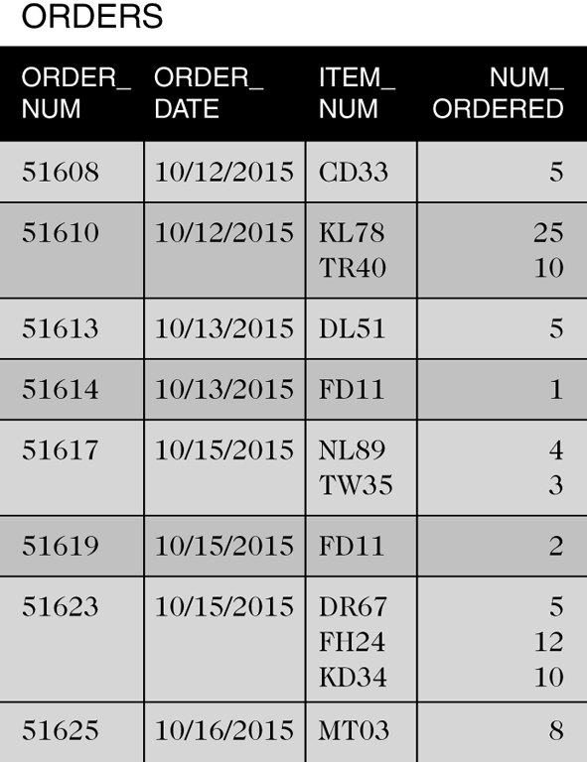
First Normal Form (continued)
Figure 2-7 Unnormalized order data
©2016 Cengage Learning. All Rights Reserved. May not be copied, scanned, or duplicated, in whole or in part, except for use as permitted in a license distributed with a certain product or service or otherwise on a password-protected website for classroom use.

Slide 25
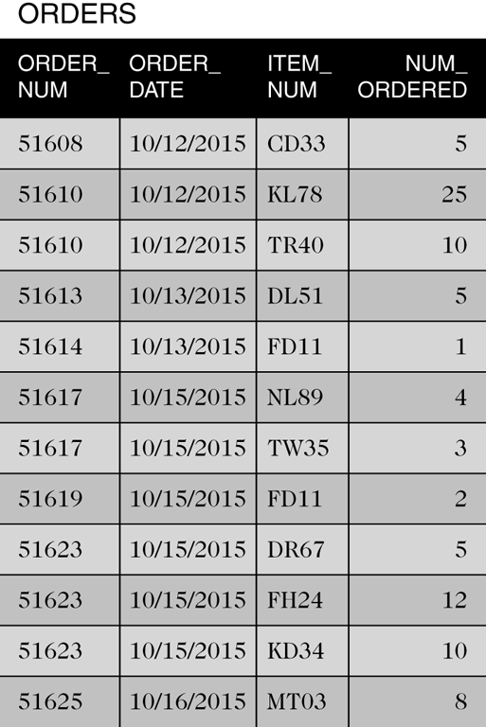
First Normal Form (continued)
Figure 2-8 Order data converted to first normal form
©2016 Cengage Learning. All Rights Reserved. May not be copied, scanned, or duplicated, in whole or in part, except for use as permitted in a license distributed with a certain product or service or otherwise on a password-protected website for classroom use.

Slide 26
Second Normal Form
Redundancy causes problems
Update Anomalies
  Update
  Inconsistent data
  Additions
  Deletions
©2016 Cengage Learning. All Rights Reserved. May not be copied, scanned, or duplicated, in whole or in part, except for use as permitted in a license distributed with a certain product or service or otherwise on a password-protected website for classroom use.

Slide 27
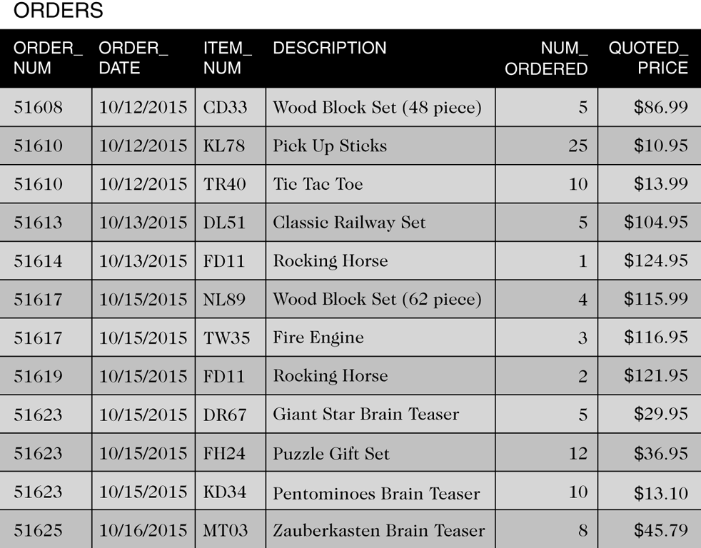
Second Normal Form (continued)
Table is in First Normal Form but not in Second Normal Form
©2016 Cengage Learning. All Rights Reserved. May not be copied, scanned, or duplicated, in whole or in part, except for use as permitted in a license distributed with a certain product or service or otherwise on a password-protected website for classroom use.

Slide 28
Second Normal Form (continued)
A relation is in second normal form (2NF) if it is in 1NF and no nonkey attribute is dependent on only a portion of the primary key
or …
All nonkey attributes are functionally dependent on the entire primary key
©2016 Cengage Learning. All Rights Reserved. May not be copied, scanned, or duplicated, in whole or in part, except for use as permitted in a license distributed with a certain product or service or otherwise on a password-protected website for classroom use.

Slide 29
Second Normal Form (continued)
A 1NF relation with a primary key that is a single field is in 2NF automatically
©2016 Cengage Learning. All Rights Reserved. May not be copied, scanned, or duplicated, in whole or in part, except for use as permitted in a license distributed with a certain product or service or otherwise on a password-protected website for classroom use.

Slide 30
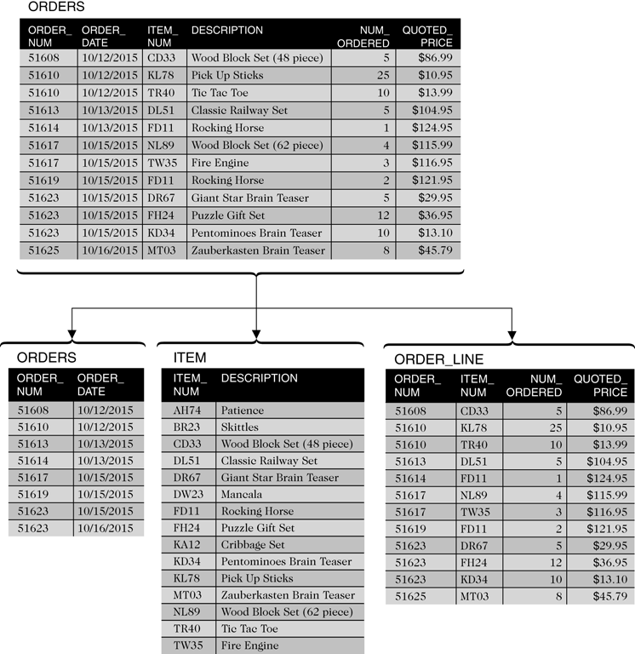
Second Normal Form (continued)
Figure 2-10 ORDERS table converted to second normal form
©2016 Cengage Learning. All Rights Reserved. May not be copied, scanned, or duplicated, in whole or in part, except for use as permitted in a license distributed with a certain product or service or otherwise on a password-protected website for classroom use.

Slide 31
Third Normal Form
Update anomalies still possible
Determinant
  An attribute (or collection) that functionally determines another attribute
©2016 Cengage Learning. All Rights Reserved. May not be copied, scanned, or duplicated, in whole or in part, except for use as permitted in a license distributed with a certain product or service or otherwise on a password-protected website for classroom use.

Slide 32
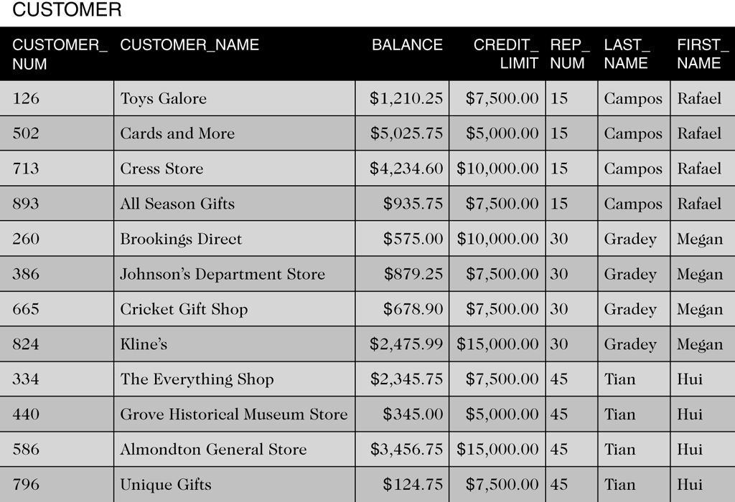
Third Normal Form (continued)
Table is in Second Normal Form but not in Third Normal Form
©2016 Cengage Learning. All Rights Reserved. May not be copied, scanned, or duplicated, in whole or in part, except for use as permitted in a license distributed with a certain product or service or otherwise on a password-protected website for classroom use.

Slide 33
Third Normal Form (continued)
A relation is in third normal form (3NF) if it is in 2NF and the only determinants it contains are candidate keys
Boyce-Codd normal form (BCNF) is the true name for this version of 3NF
©2016 Cengage Learning. All Rights Reserved. May not be copied, scanned, or duplicated, in whole or in part, except for use as permitted in a license distributed with a certain product or service or otherwise on a password-protected website for classroom use.

Slide 34
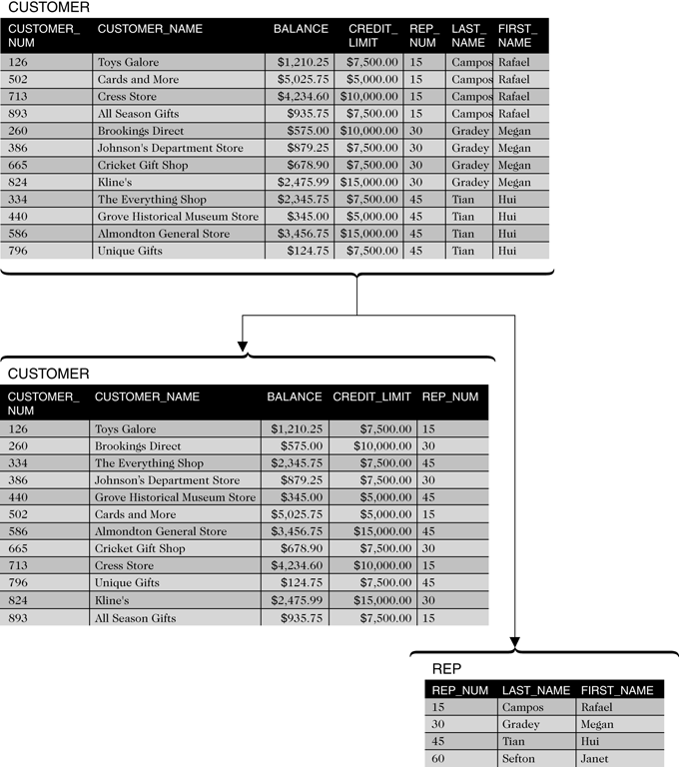
Third Normal Form (continued)
Figure 2-12 CUSTOMER table converted to third normal form
©2016 Cengage Learning. All Rights Reserved. May not be copied, scanned, or duplicated, in whole or in part, except for use as permitted in a license distributed with a certain product or service or otherwise on a password-protected website for classroom use.

Slide 35
Diagrams for Database Design
Graphical illustration
Entity-relationship (E-R) diagram
  Rectangles represent entities
  Arrows represent relationships
©2016 Cengage Learning. All Rights Reserved. May not be copied, scanned, or duplicated, in whole or in part, except for use as permitted in a license distributed with a certain product or service or otherwise on a password-protected website for classroom use.

Slide 36
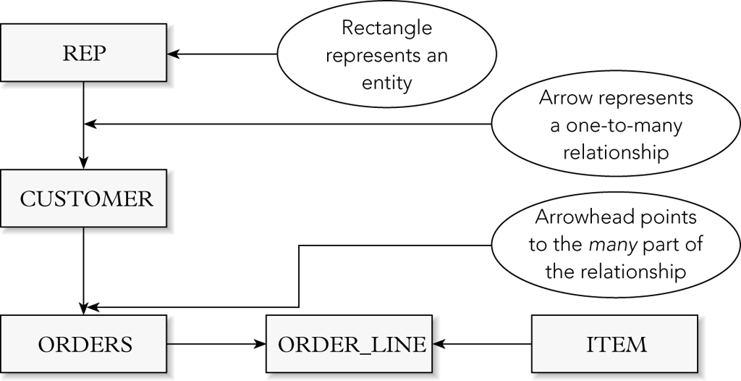
Diagrams for Database Design (continued)
Figure 2-13 E-R diagram for the TAL Distributors database with rectangles and arrows
©2016 Cengage Learning. All Rights Reserved. May not be copied, scanned, or duplicated, in whole or in part, except for use as permitted in a license distributed with a certain product or service or otherwise on a password-protected website for classroom use.

Slide 37
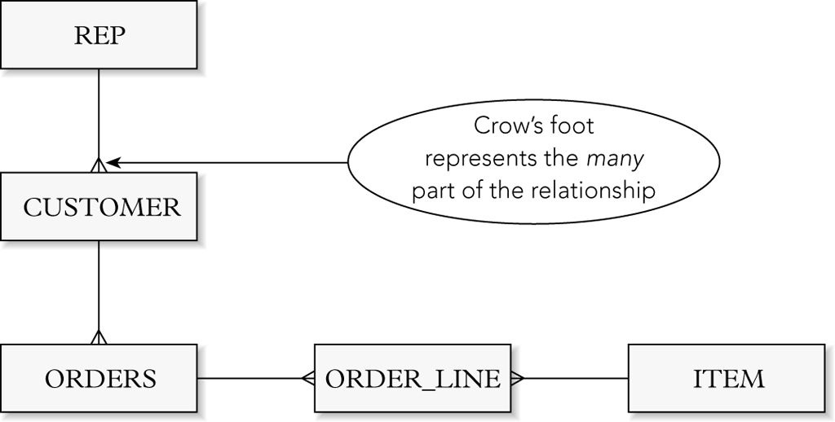
Diagrams for Database Design (continued)
Figure 2-14 E-R diagram for the TAL Distributors database with a crow’s foot
©2016 Cengage Learning. All Rights Reserved. May not be copied, scanned, or duplicated, in whole or in part, except for use as permitted in a license distributed with a certain product or service or otherwise on a password-protected website for classroom use.

Slide 38
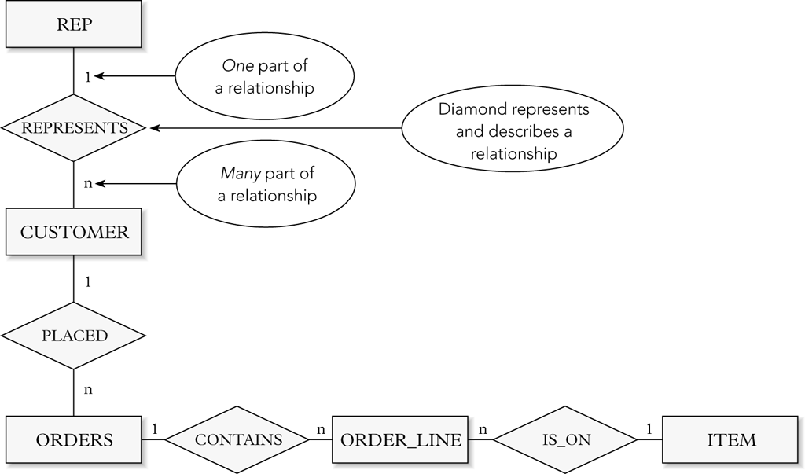
Diagrams for Database Design (continued)
Figure 2-15 E-R diagram for the TAL Distributors database with named relationships
©2016 Cengage Learning. All Rights Reserved. May not be copied, scanned, or duplicated, in whole or in part, except for use as permitted in a license distributed with a certain product or service or otherwise on a password-protected website for classroom use.

Slide 39
Summary
Definition of entity
Definition of attribute
Definition of relationship
Definition of relation
Definition of functional dependence
Definition of primary key
Database design method
©2016 Cengage Learning. All Rights Reserved. May not be copied, scanned, or duplicated, in whole or in part, except for use as permitted in a license distributed with a certain product or service or otherwise on a password-protected website for classroom use.

Slide 40
Summary (continued)
Normalization
Unnormalized (repeating groups)
First normal form (INF)
Second normal form (2NF)
Third normal form (3NF)
Entity-relationship diagram (E-R diagram)
©2016 Cengage Learning. All Rights Reserved. May not be copied, scanned, or duplicated, in whole or in part, except for use as permitted in a license distributed with a certain product or service or otherwise on a password-protected website for classroom use.

